Slide 1
Software Analysis and Design
Conceptual Models: Behavioural Models
State Diagram
Department of Software Engineering,
FAST-NUCES, CFD Campus

Slide 2
Lecture Material
System Analysis and Design in a Changing World (Chapter 5)

Slide 3
Behavior Models – Event Driven Modelling
Real-time systems are often event-driven, with minimal data processing. For example, a landline phone switching system responds to events such as ‘receiver off hook’ by generating a dial tone.
Event-driven modeling shows how a system responds to external and internal events.
It is based on the assumption that a system has a finite number of states and that events (stimuli) may cause a transition from one state to another.
State machines is the most widely used model for event driven scenarios.

Slide 4
Behavior Models – State Machines
A state machine diagram shows the lifecycle of an object: what events it experiences, its transitions, and the states it is in between these events.
  Events may be internal or external.
  System states are nodes and events as arcs between these nodes. When an event occurs, the system moves from one state to another.
Statecharts are an integral part of the UML and are used to represent state machine models.

Slide 5
Behavior Models – State Machines – Types of Events
External Event – Events caused by an outside actor, outside of the system’s boundary.
Internal Event – Events caused by an internal action, inside the system’s boundary.
Temporal Event – Events caused by a determined date or time clock.

Slide 6
Behavior Models – State Machines – States
If an object always responds the same way to an event, then it is considered state-independent (or modeless) wrt that event.
By contrast, state-dependent objects react differently to events depending on their state or mode.
  Telephone states
Guideline: Consider state machines for state-dependent objects with complex behavior, not for state-independent objects, why?

Slide 7
Behavior Models – State Machines – States
Physical Devices controlled by Software
  Microwave oven, Radio
Transactions - The way transaction respond to events
  Cancel a sale
Role Mutators, i.e., Objects that change their role.
  Full-time vs. half-time worker
Communication Protocols
UI Page/Window Flow or Navigation
UI Flow Controllers or Stateful Sessions
  Server-side software objects
Use Case System Operations
  For Process Sale: makeNewSale, enterItem, etc.
Individual UI Window Event Handling
  Window’s action “Edit-Copy”

Slide 8
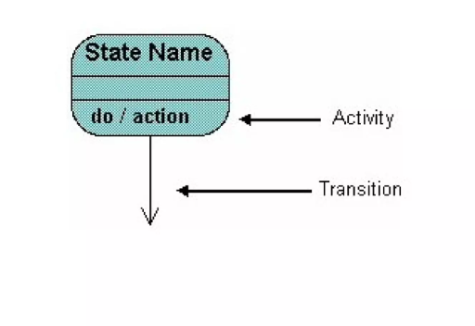
Behavior Models – State Machines - Notations

Slide 9
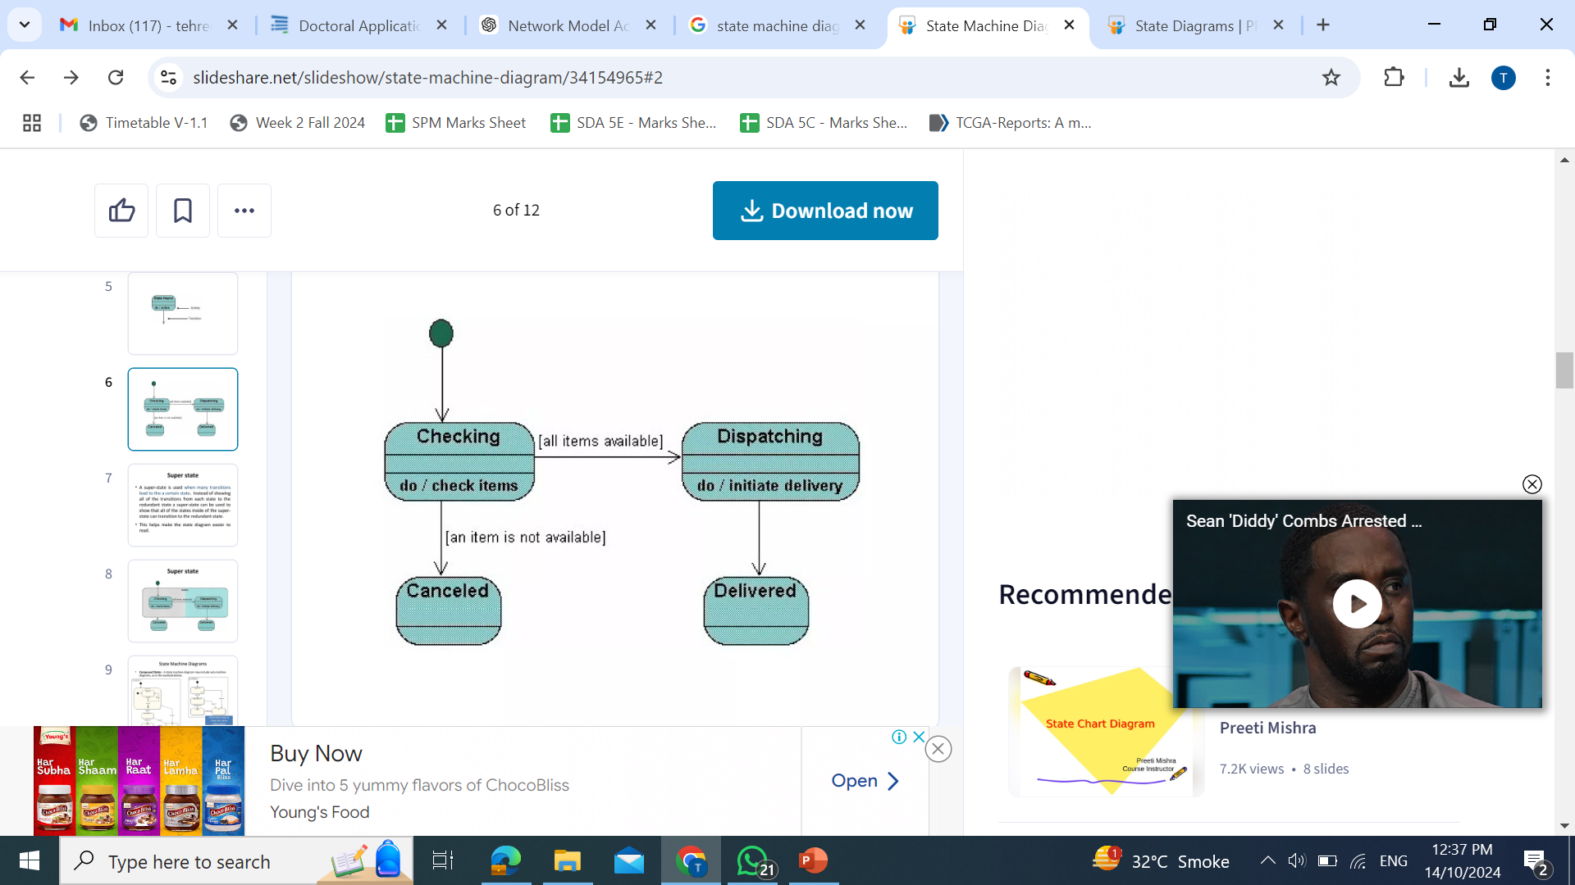
Behavior Models – State Machines

Slide 10
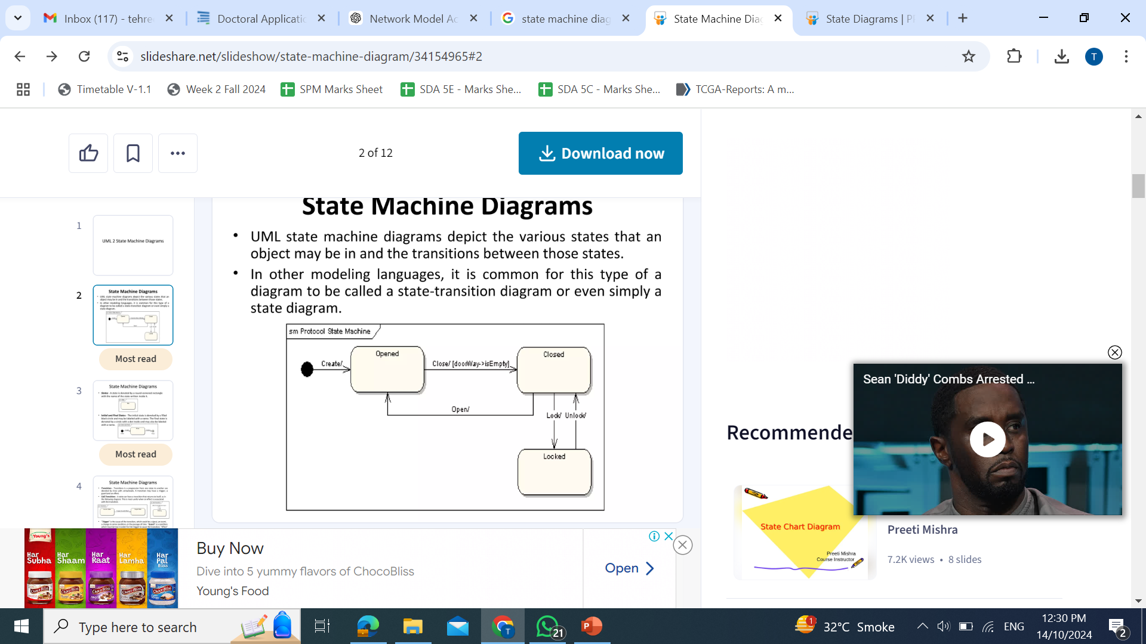
Behavior Models – State Machines

Slide 11
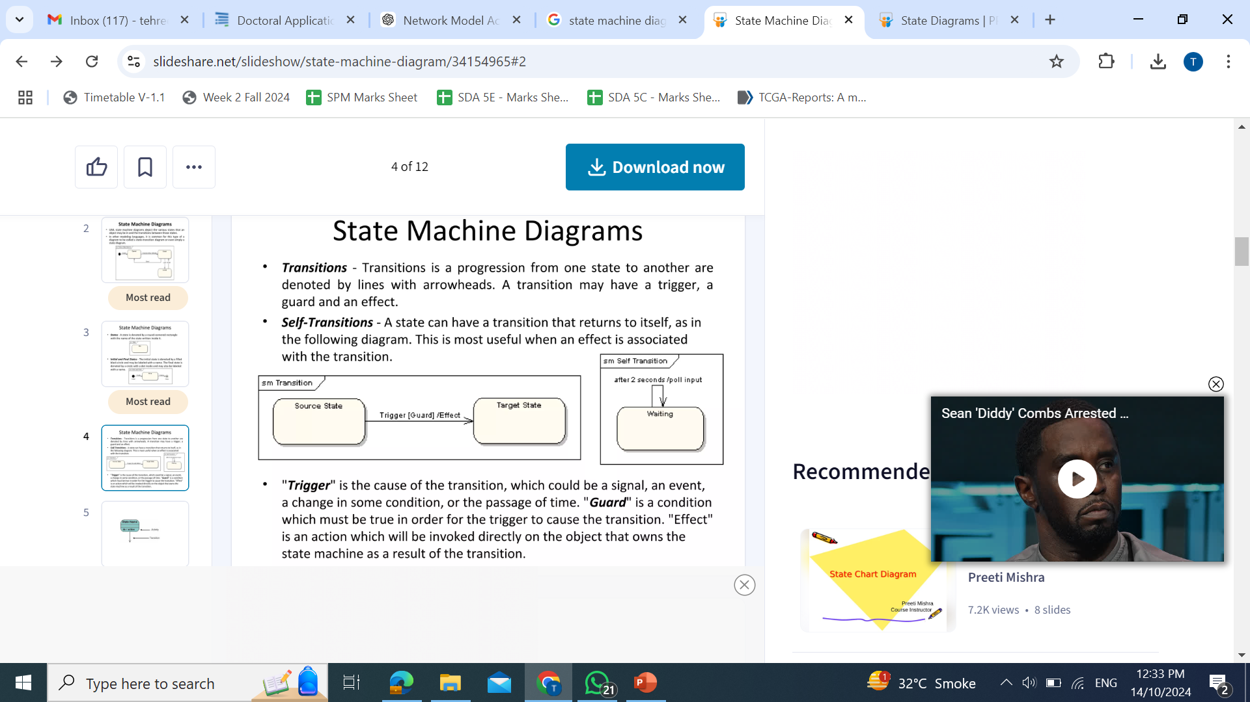
Behavior Models – State Machines

Slide 12
Behavior Models – State Machines – States
A state may be represented as nested substates.
  In UML, substates are shown by nesting them in a superstate box.
A substate inherits the transitions of its superstate.

Slide 13
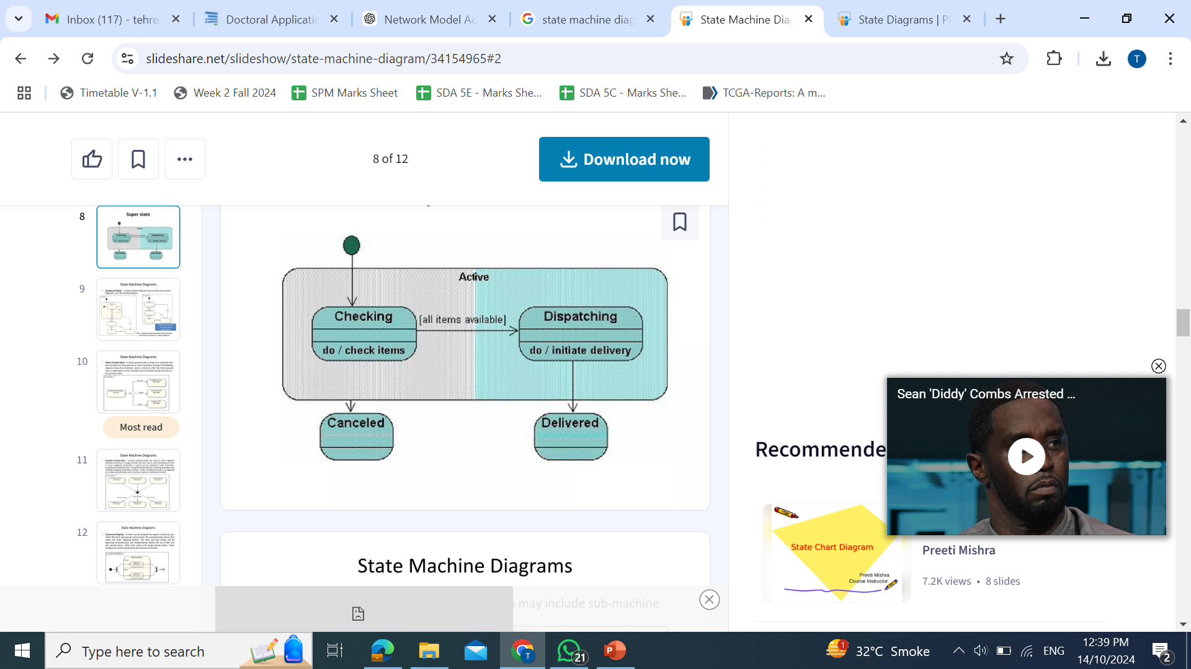
Behavior Models – State Machines – States

Slide 14
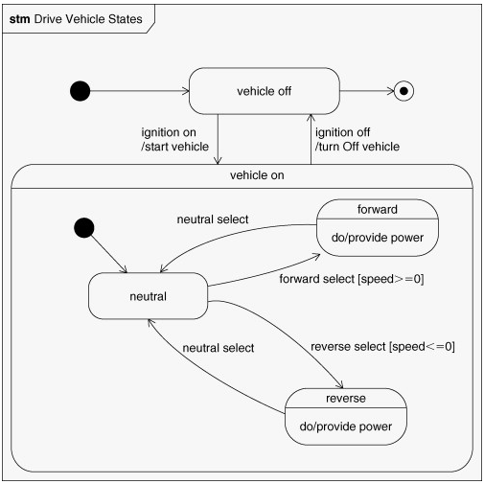
Behavior Models – State Machines – Nested States

Slide 15
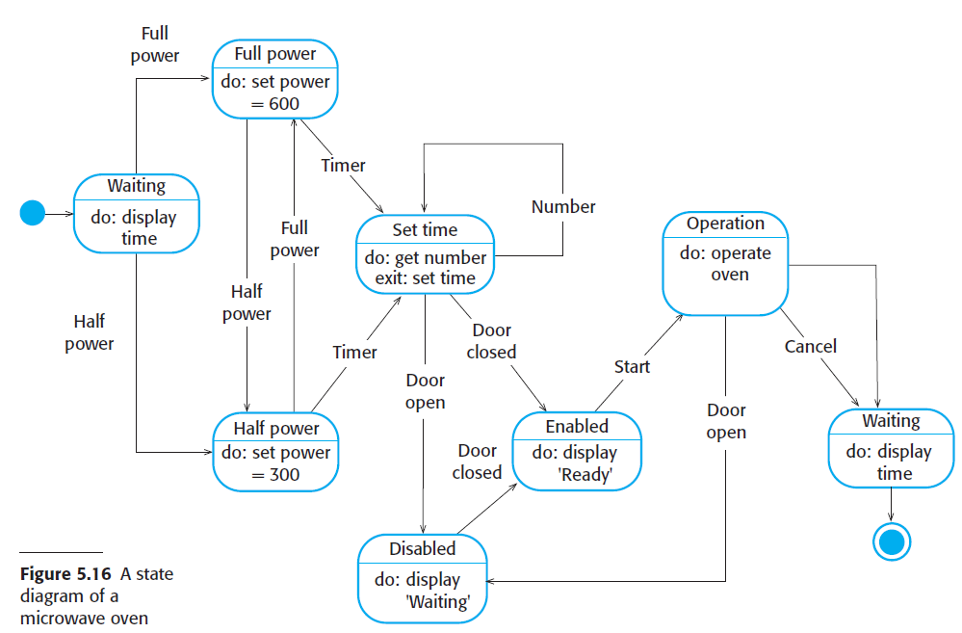
Behavior Models – State Machines

Slide 16
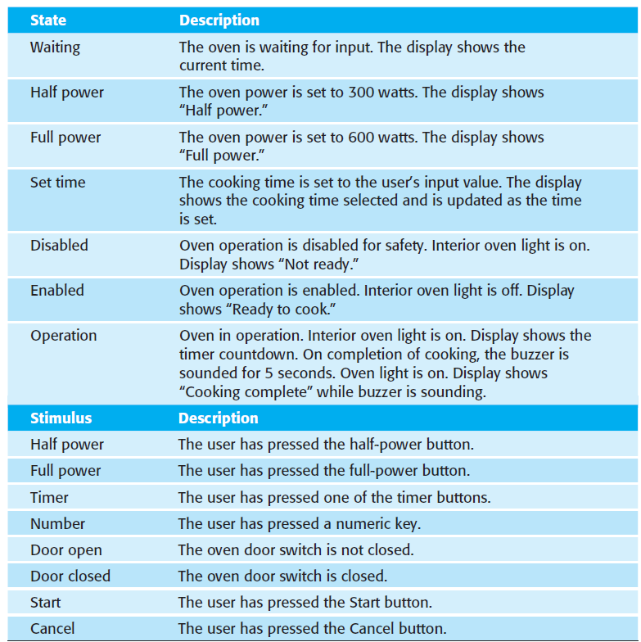
Behavior Models – State Machines

Slide 17
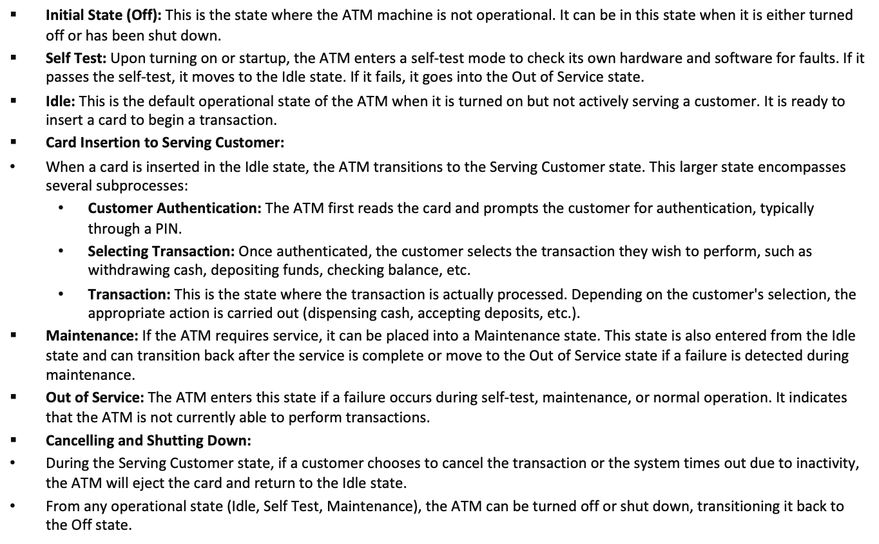
State Diagram of ATM

Slide 18
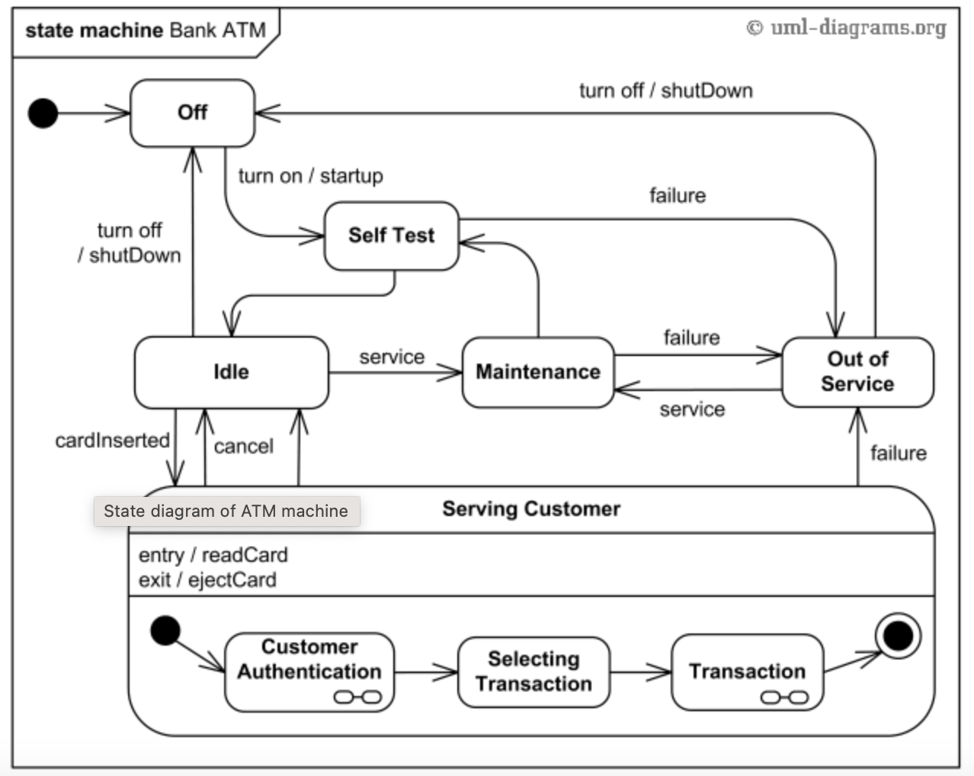
State Diagram of ATM

Slide 19
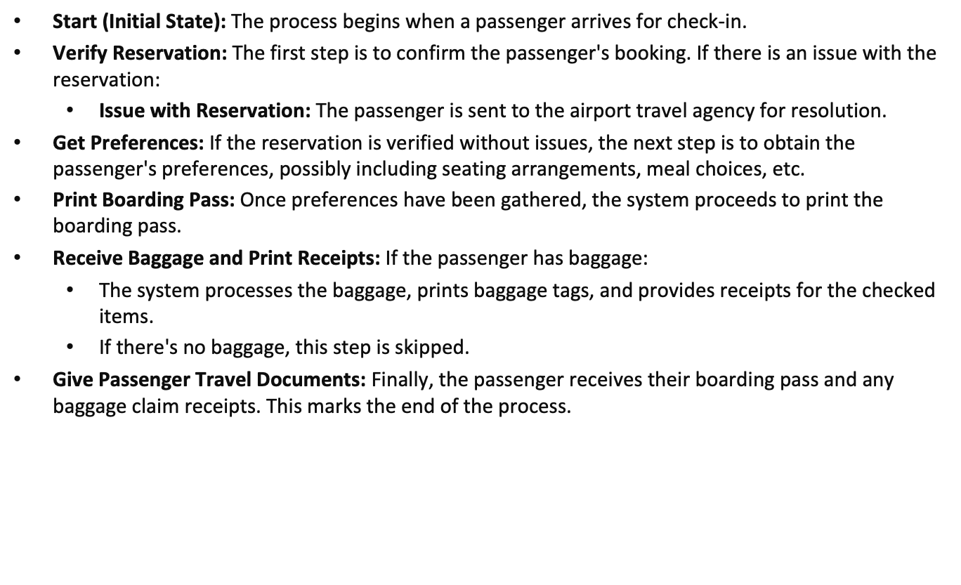
State Diagram of Airport Processing

Slide 20
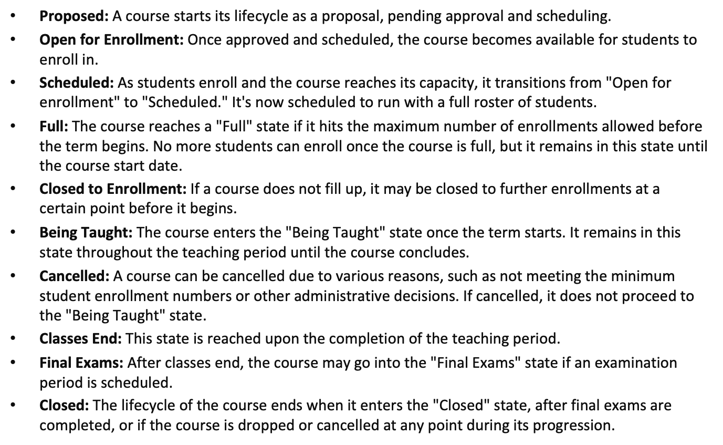
State Diagram of Course Enrollment System

Slide 21
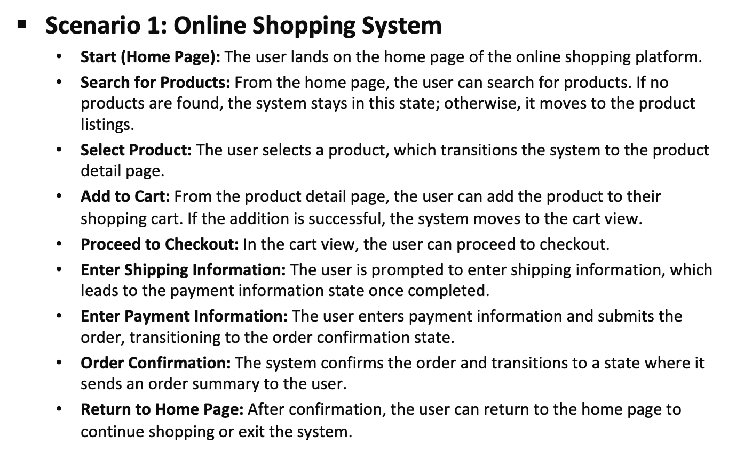

Slide 22
